Slide 1
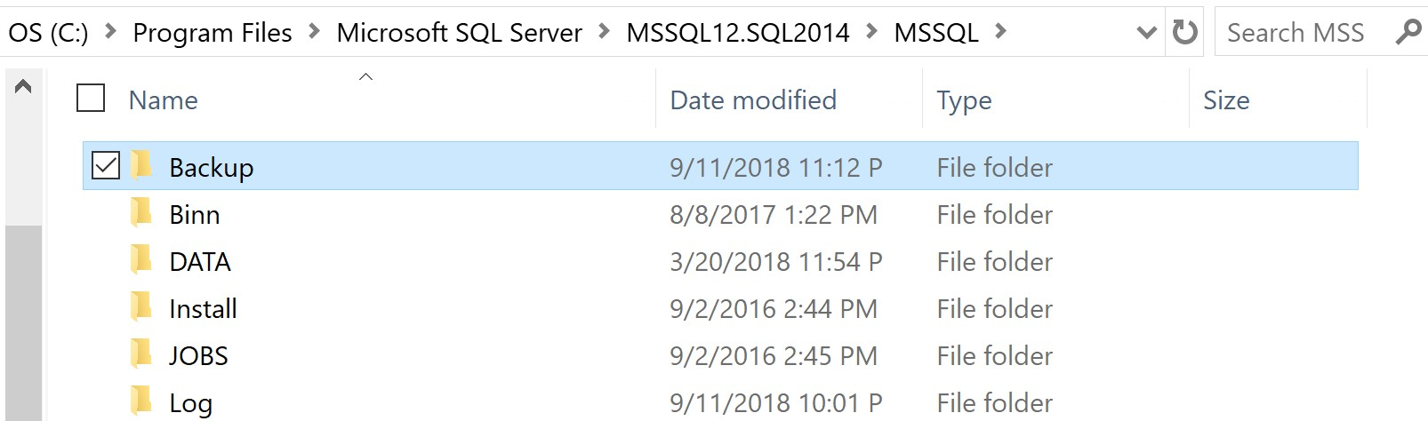
Store the NewPVF.BAK file
1. Put the NewPVF.BAK file inside this Backup folder. If necessary, create the Backup folder first.

Slide 2
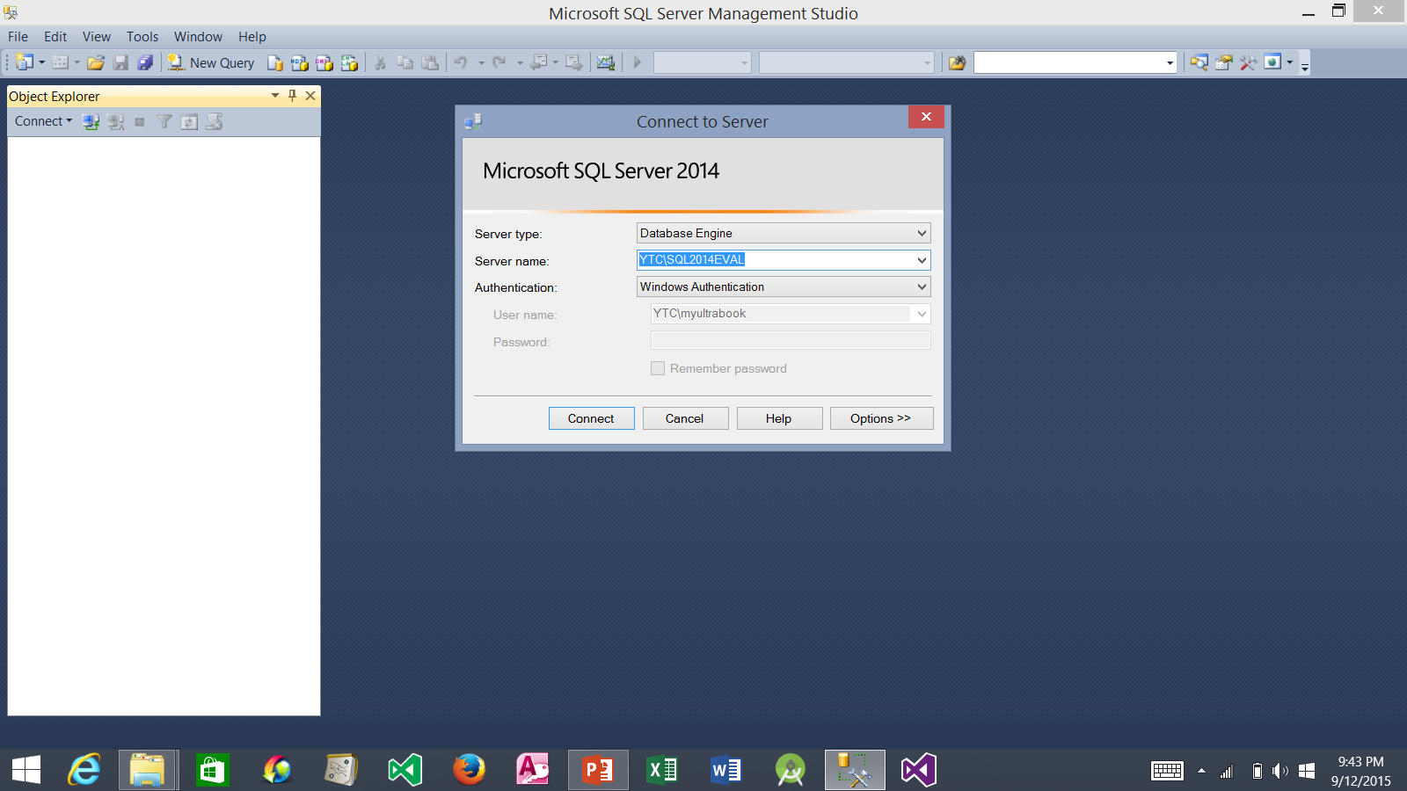
Launch SQL Server 2014 and Login
1. Select Database Engine
2. Specify YourComputerName/DatabaseInstanceName
3. Click Connect

Slide 3
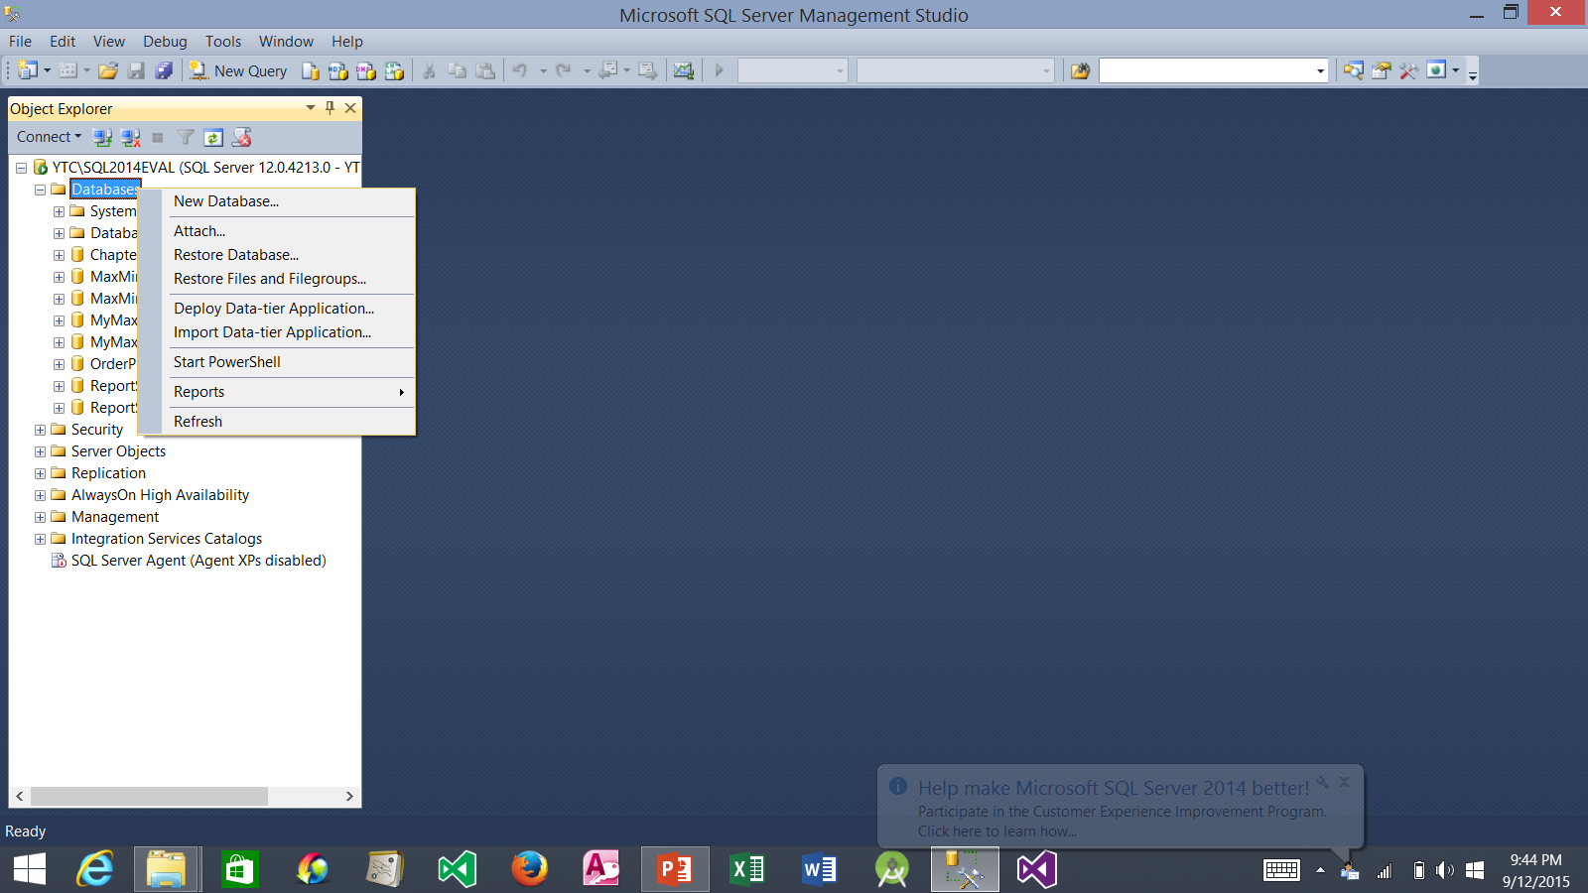
Select Restore Database
1. Right-click Database node
2. Select Restore Database…

Slide 4
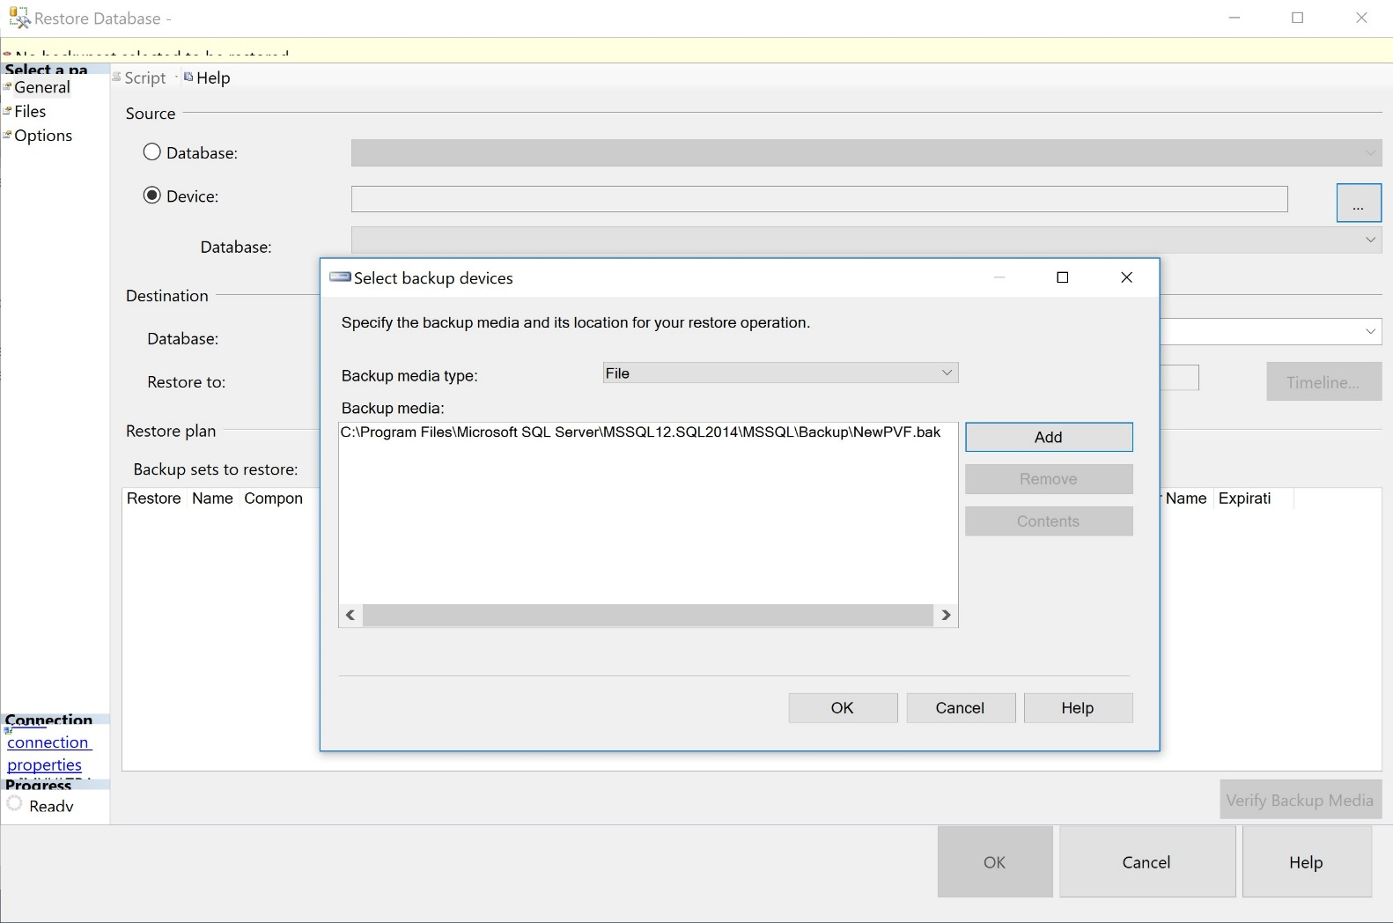
1. Be sure General is selected
2. Select Device
3. Click this button
4. Select backup devices window should pop up.
5. Click Add button

Slide 5
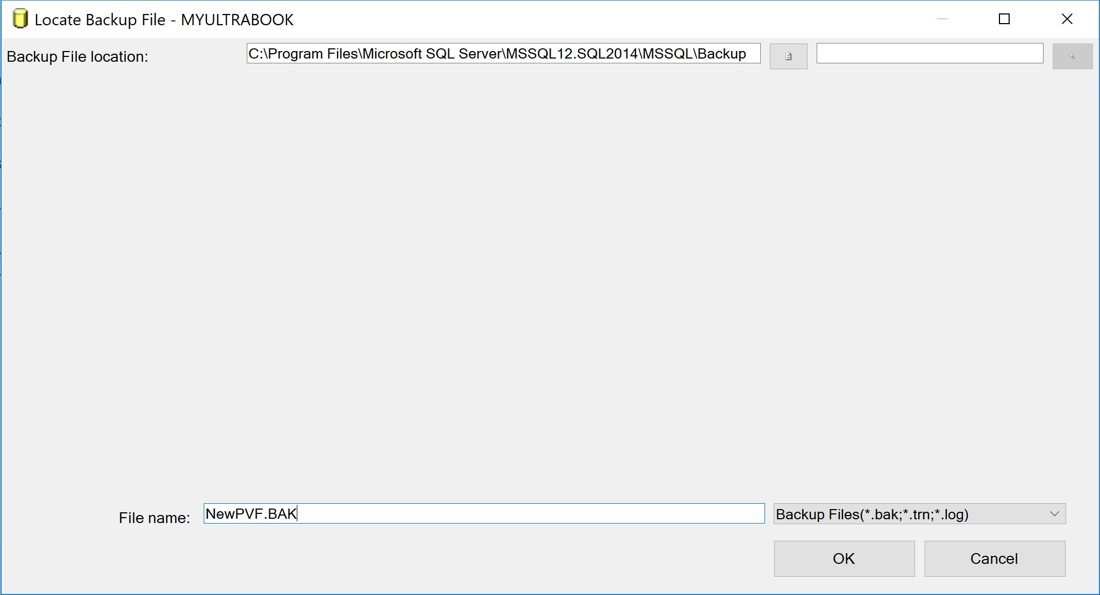
1. Enter the path to your backup file folder
2. Enter the backup file name
3. Click OK button

Slide 6
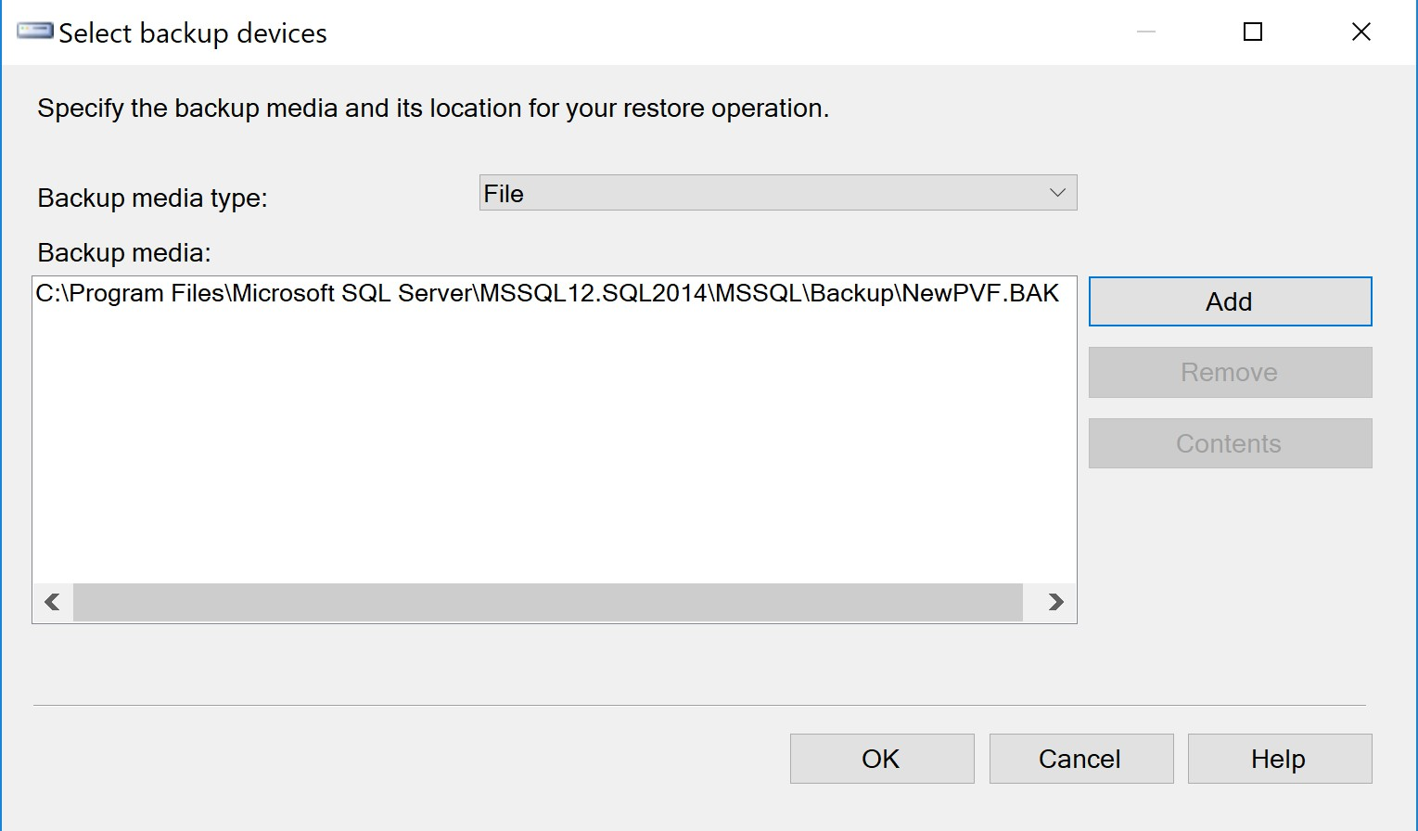
1. Click OK button

Slide 7
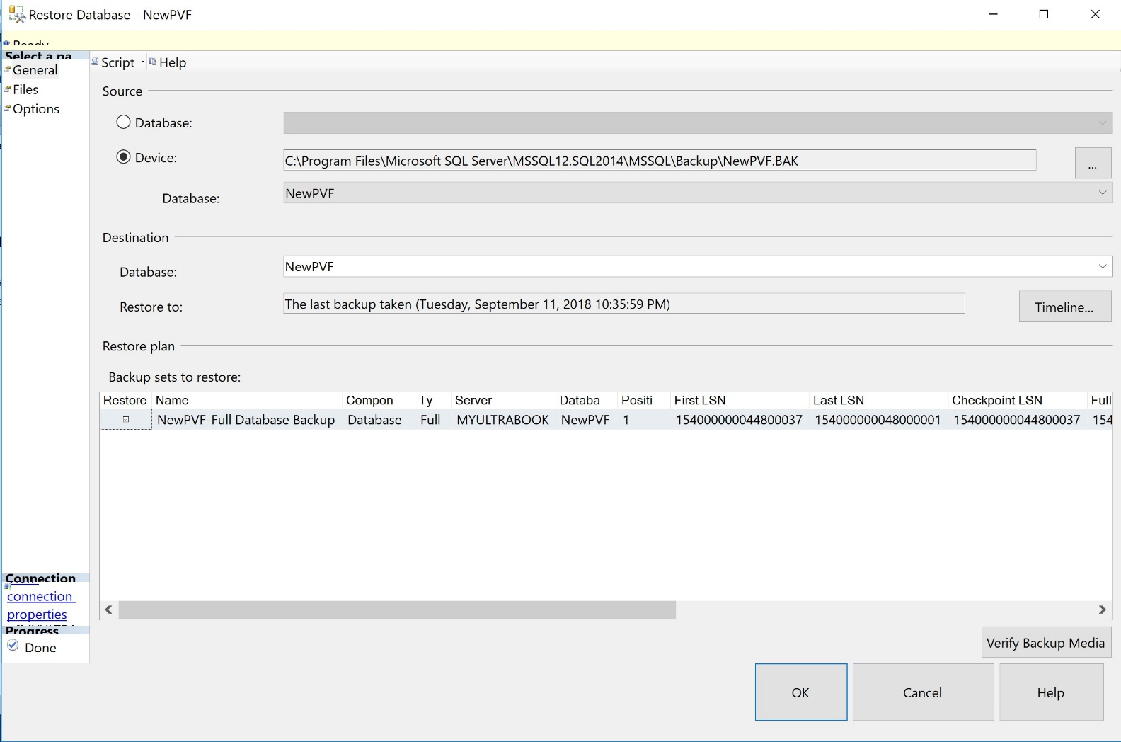
1. Click Options node

Slide 8
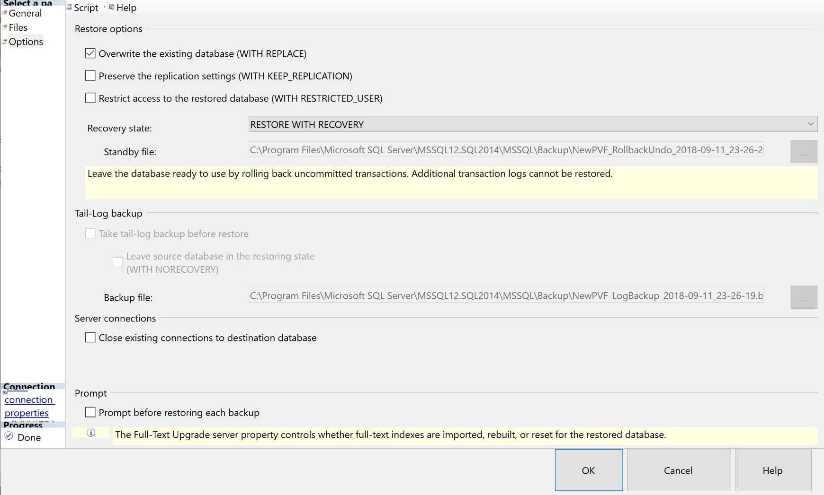
1. Put a checkmark to overwrite existing NewPVF database
2. Click OK button

Slide 9
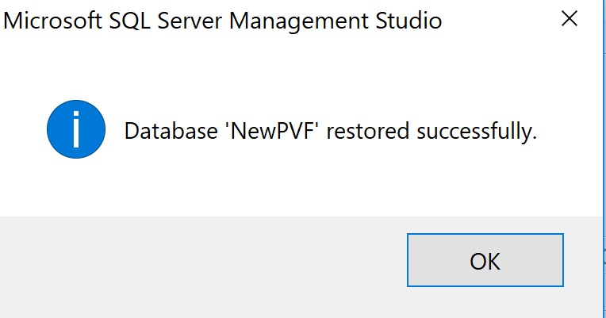
1. Successful message
2. Click OK button

Slide 10
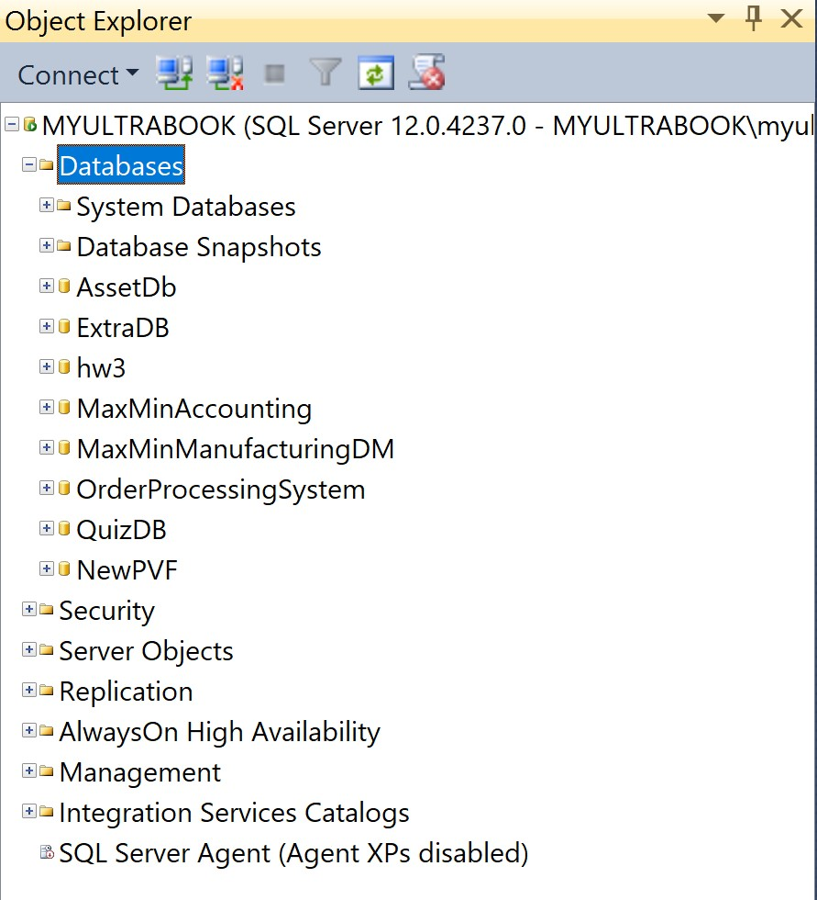
1. NewPVF database is ready to use.

